Slide 1

Enginius
Price Optimization –Office Star
Minder Chen, CSU Channel Islands
Copyright (c) 2022, DecisionPro Inc.
You know the old saw (wise saying) about "Lies, damned lies, and statistics," right? It rings true because statistics really is as much about interpretation and presentation as it is mathematics. That means we human beings who are analyzing data, with all our foibles and failings, have the opportunity to shade and shadow the way results get reported.

Slide 2
OFFICESTAR: PRICE OPTIMIZATION
Gabor Granger is a survey-based research technique used to determine the optimal price for a product or service. A Gabor Granger question asks respondents to evaluate a series of pre-defined price points. The results are used to build a demand curve and determine the revenue-maximizing price point.
https://www.surveyking.com/help/gabor-granger
The sole purpose of this data set is to show the basic functionalities of the price optimization model.
In this example, an office-supply company named OfficeStar surveyed its customers about their likelihood of purchasing a warranty option at various price points. It is expected that each warranty will cost an average of $7 ($10 is used in the final analysis) to the company.
Click on RUN PRICE OPTIMIZATION to find the price points that maximizes revenue and profit.

Slide 3
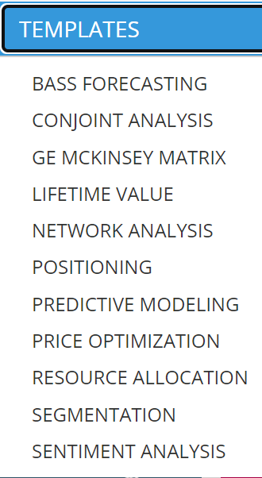
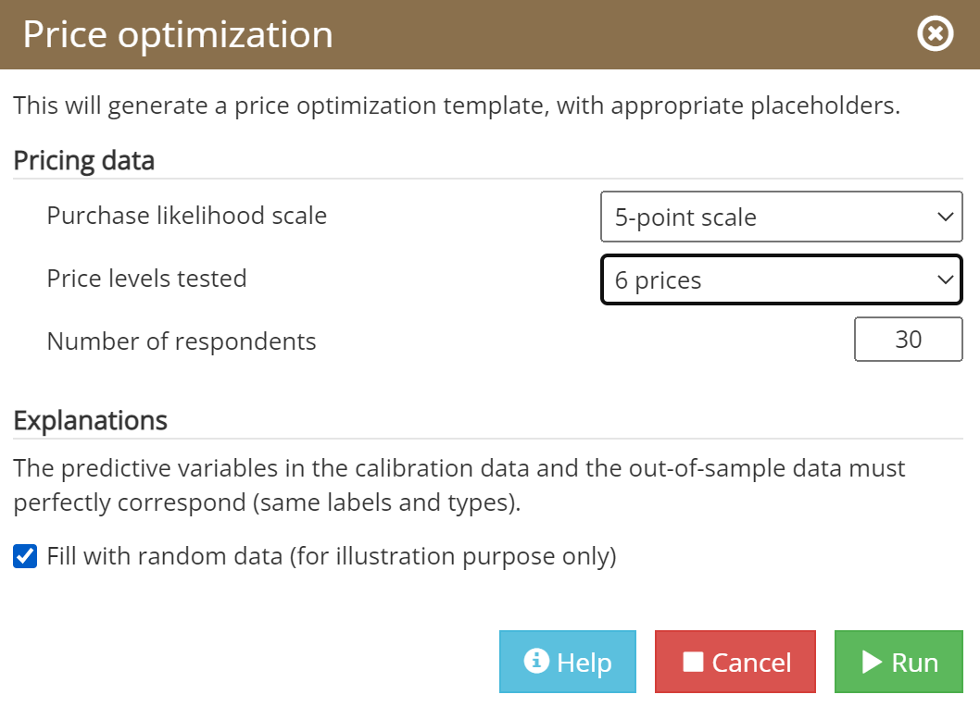
Use Enginius Template function to Generate Input Data Template

Slide 4
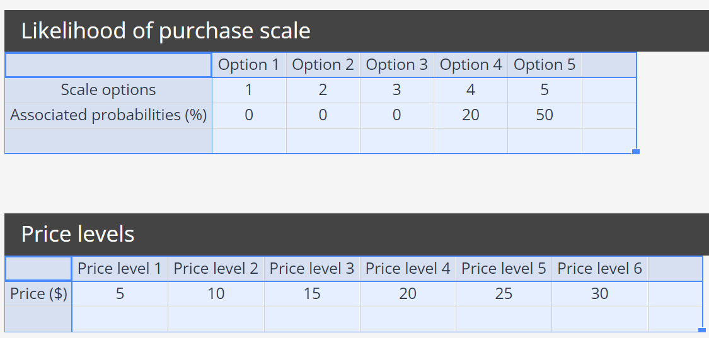
Input Data Template Generated (to be modified)
Associated probabilities assigned to the scale (1-5) can be modified.
The different prices used are entered into this table, in increasing order (from the lowest tested price level to the highest one).

Slide 5
Flow of Gabor-Granger questions
Each respondent is given a series of almost identical questions such as “Would you buy product X at price Y?”. In each of the several questions, the price shown to a respondent is different: it is adapted based on the respondent's previous answer with the aim to find the maximum price each respondent is willing to pay for a product. In this example, we have price points from $50 to $170 (incremented by $10):
Respondents are randomly assigned to one price.
If they are willing to pay that price, they are offered a higher (randomly chosen) price.
If they are not willing to pay that price, they are offered a lower (randomly chosen) price.
The algorithm repeats until we find the highest price each respondent is willing to pay.
https://conjointly.com/products/gabor-granger/

Slide 6
Input Data (based on the Templates Generated)
 | Likelihood of purchase scale (5 Lickert scale)
\ | Option 1 | Option 2 | Option 3 | Option 4 | Option 5
Scale options | 1 | 2 | 3 | 4 | 5
Associated probabilities (%) | 0 | 0 | 0 | 20 | 50
 | Price levels
\ | Price level 1 | Price level 2 | Price level 3 | Price level 4 | Price level 5 | Price level 6
Price ($) | 5 | 10 | 15 | 20 | 25 | 30
“will never buy”, “will probably not buy”, “may or may not buy”, “will probably buy”, and “will definitely buy”.
Number of tested pricing levels: The number of pricing levels being evaluated in the study. A respondent will be asked as many questions as there are specified pricing levels. To allow for accurate model interpolation, there should be at the very least 3 or 4 pricing levels (8-16 are suggested), but it is usually safer to go with more.
內插，或稱插值（英語：Interpolation），是一種通过已知的、离散的数据點，在範圍內推求新數據點的过程或方法。

Slide 7
There are two biases in the Gabor-Granger methodology, which mostly cancel each other out:
Understatement of willingness to pay: Where a price is shown explicitly, respondents can reckon that the purpose of the study is to set a price. They may be tempted to understate their willingness to pay to “game” the company into offering lower prices.
Overstatement of purchase intention: While respondents may state a willingness to purchase a product in a survey, real-life purchase decisions will often be swayed by many other factors and will result in a lower level of buying than reported in the test.
Intentions translated to Probabilities Table
1 | Definitely Will Not Buy | 0%
2 | Probably Will Not Buy | 0%
3 | Might Buy | 0%
4 | Probably Will Buy | 20%
5 | Definitely Will Buy | 50%
\ | Option 1 | Option 2 | Option 3 | Option 4 | Option 5
Scale options | 1 | 2 | 3 | 4 | 5
Associated probabilities (%) | 0 | 0 | 0 | 20 | 50
*** Not 100%

Slide 8
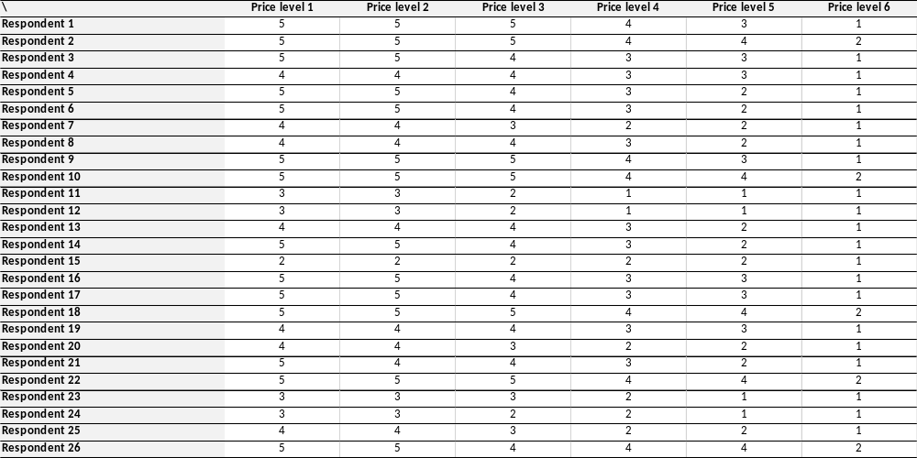
Data Input (Respondents' Data – Responses to Various Price Points)
Intentions translated to Probabilities Table
1 | Definitely Will Not Buy | 0%
2 | Probably Will Not Buy | 0%
3 | Might Buy | 0%
4 | Probably Will Buy | 20%
5 | Definitely Will Buy | 50%

Slide 9
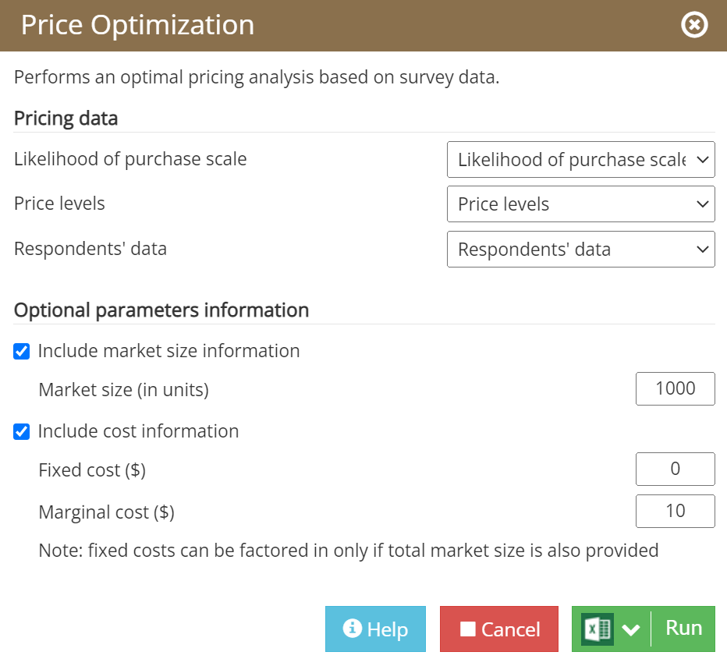
Run the Price Optimization Analysis

Slide 10
Gabor Granger Method Process
Demand Curve (Likelihood of Purchasing at various price points)
Find Prices that maximize Revenue & Profit
Survey Design and Customer Data
Likelihood of purchase scale
Price levels
Respondents' data
Gabor Granger Method
Gabor Granger is used to build a demand curve and find the revenue-maximizing price.

Slide 11
Gabor-Granger Pricing Method
Customers are asked to indicate their buying intention for a product at a number of price levels
  1 = Will never buy
  …
  4 = Likely to buy
  5 = Will absolutely buy
These answers are then transformed into probabilities
  E.g., 4=20%; 5=50%; anything else set at 0%.
  Ideally, these figures are calibrated on existing data
You need to specify several price levels (ideally, between 8 and 15 price levels, for example: $10, $20, $30, $40, $50, $60, $70, $80, $90. You will also need to provide a description of your product (e.g., a list of features for a software plan).
Price levels are presented randomly and in different order for each respondent (reduces rationalization, bias)
**Demand curve and price elasticity are estimated based on all responses
Intentions translated to Probabilities Table
1 | Definitely Will Not Buy | 0%
2 | Probably Will Not Buy | 0%
3 | Might Buy | 10%
4 | Probably Will Buy | 20%
5 | Definitely Will Buy | 50%
** https://conjointly.com/products/gabor-granger/ https://en.wikipedia.org/wiki/Gabor%E2%80%93Granger_method

Slide 12
Gabor-Granger Method: Buying intention ➔ Purchasing probability
Buying intention in 5-licket scale
for a product at a number of price levels
  1 = Will never buy
  …
  4 = Likely to buy
  5 = Will absolutely buy
Customer's probability of buying
a product at a number of price levels
Intentions translated to Probabilities Table
1 | Definitely Will Not Buy | 0%
2 | Probably Will Not Buy | 0%
3 | Might Buy | 10%
4 | Probably Will Buy | 20%
5 | Definitely Will Buy | 50%
 | Answer
Customer | €4 | €6 | €8 | €10 | €12
A | 0.5 | 0.5 | 0.5 | 0.5 | 0.2
B | 0.5 | 0.5 | 0.2 | 0 | 0
C | 0.5 | 0.5 | 0.2 | 0 | 0
D | 0.2 | 0.2 | 0 | 0 | 0
E | 0.5 | 0.5 | 0.2 | 0 | 0
F | 0.5 | 0.5 | 0.5 | 0.2 | 0.2
G | 0.2 | 0 | 0 | 0 | 0
H | 0.2 | 0.2 | 0 | 0 | 0
I | 0.5 | 0.2 | 0.2 | 0 | 0
J | 0.5 | 0.2 | 0.2 | 0 | 0
K | 0 | 0 | 0 | 0 | 0
L | 0 | 0 | 0 | 0 | 0
M | 0.2 | 0.2 | 0.2 | 0 | 0
N | 0.5 | 0.5 | 0.5 | 0.2 | 0.2
O | 0 | 0 | 0 | 0 | 0
P | 0.5 | 0.5 | 0.5 | 0.2 | 0
 | Answer
Customer | €4 | €6 | €8 | €10 | €12
A | 5 | 5 | 5 | 5 | 4
B | 5 | 5 | 4 | 3 | 3
C | 5 | 5 | 4 | 3 | 3
D | 4 | 4 | 3 | 2 | 1
E | 5 | 5 | 4 | 3 | 3
F | 5 | 5 | 5 | 4 | 4
G | 4 | 3 | 3 | 2 | 1
H | 4 | 4 | 3 | 2 | 1
I | 5 | 5 | 4 | 3 | 3
J | 5 | 5 | 4 | 3 | 3
K | 3 | 3 | 2 | 2 | 1
L | 3 | 3 | 3 | 2 | 1
M | 4 | 4 | 4 | 3 | 3
N | 5 | 5 | 5 | 4 | 4
O | 2 | 2 | 1 | 1 | 1
P | 5 | 5 | 5 | 4 | 3
These answers are then transformed into probabilities.
4=20%; 5=50%; anything else (1,2,3) set at 0%.
Note that respondents are notoriously known to overstate their purchase probabilities, so that associated probabilities are rarely higher than 50%, even for the highest options on the scale.

Slide 13
The Usages of Gabor Granger Method
Gabor Granger is primarily used in pricing research to answer these three questions:
Can the price of a product be increased without affecting sales (demand)
At what price point does the demand start to decline drastically
What is the price that results in the largest expected revenue
Gabor Granger is ideal for pricing studies that fit into these categories:
You have an established product and need to optimize for a proposed price increase.
You're an established company looking to update an existing product and are researching a new price on the improved product.
The product being researched has all price points under $25. At this price, Van Westendorp becomes too cumbersome for respondents.

Slide 14
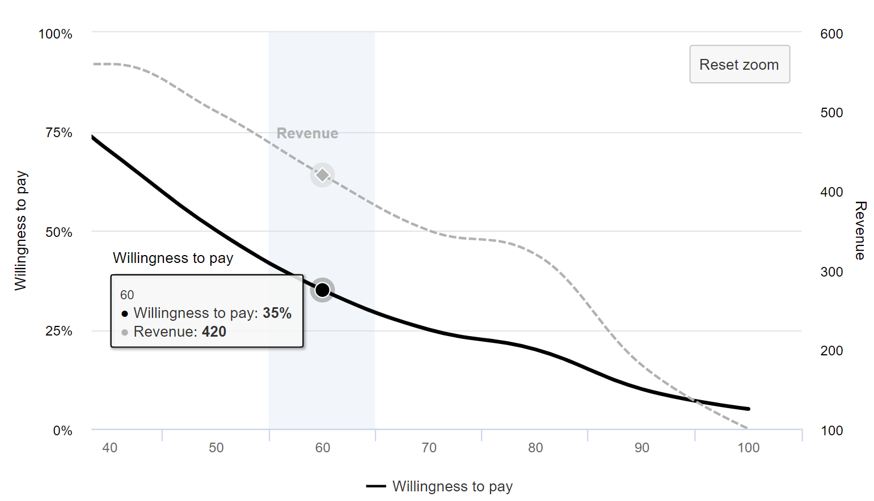
Demand Curve and Revenue
We need to know cost function to find the Price that maximize Profit.
This is not Office Star Case's Output
https://www.youtube.com/watch?v=qNONNu6aJWM

Slide 15
Gabor-Granger Output
Revenue
or
Profit
This is not Office Star Case's Output
OPTIMAL PRICING
Price
Price | €4 | €6 | €8 | €10 | €12
Sales | 8.4 | 7.6 | 5.3 | 1.9 | 0.9
Margins | €33.6 | €45.6 | €42.4 | €19.0 | €10.8

Slide 16
Gabor-Granger method
The Gabor-Granger method is especially suited for optimizing price when all the other components (or attributes) of the product or service are fixed and cannot be changed.
When the firm can change product attributes other than price (e.g., design, quality, power), it would be more appropriate to use Conjoint Analysis, where price is only one of the attributes among many.
https://en.wikipedia.org/wiki/Gabor%E2%80%93Granger_method

Slide 17
Gabor-Granger
Pros:
  Simple design
  One measurement per price level
  Robust, proven method
Cons:
  No margins of error (can be added)
  Assumes data accuracy
  Assumes optimal price is actually measured
  (we can interpolate, but not extrapolate… What if outside range?)

Slide 18
Model selection

Slide 19
Introduction
Different models have been tested to model the data you have provided, and the one model that led to the best fit was retained.
The tested models differ in the way the influence of price is encoded. The price influence can be:
Linear (price)
Logarithmic (log(price))
Square root (sqrt(price))
Different combinations of the above price encodings can be combined, depending on the nature of the data.

Slide 20
Model Selection
 | Ceiling | Intercept | Price | log(Price) | sqrt(Price) | BIC | Selected
Model 1 | 0.35 | 4.88 | -0.31 |  |  | 120.74
Model 2 | 0.78 | -4.62 | -0.61 |  | 3.29 | 120.67 | YES
Model 3 | 0.61 | -2.41 | -0.40 | 2.81 |  | 120.67
Model 4 | 0.60 | -2.28 | -0.39 | 2.97 | -0.19 | 120.67
Likelihood = F(price)
Likelihood = F(price, sqrt(price))
Likelihood = F(price, log(price))
Likelihood = F(price, log(price), sqrt(price))
Pricing uses 4 different models which differ in the way the influence of price is encoded
The survey data of observed purchase behavior is best described by a logit model with the following number of parameters: 4
The estimated model has a ceiling parameter of 0.7769 . This means that the maximum attainable market share is 77.69 %
This logit model includes a ceiling, intercept and two slope parameters.
Likelihood is a logit function of price and the square root of price.

Slide 21
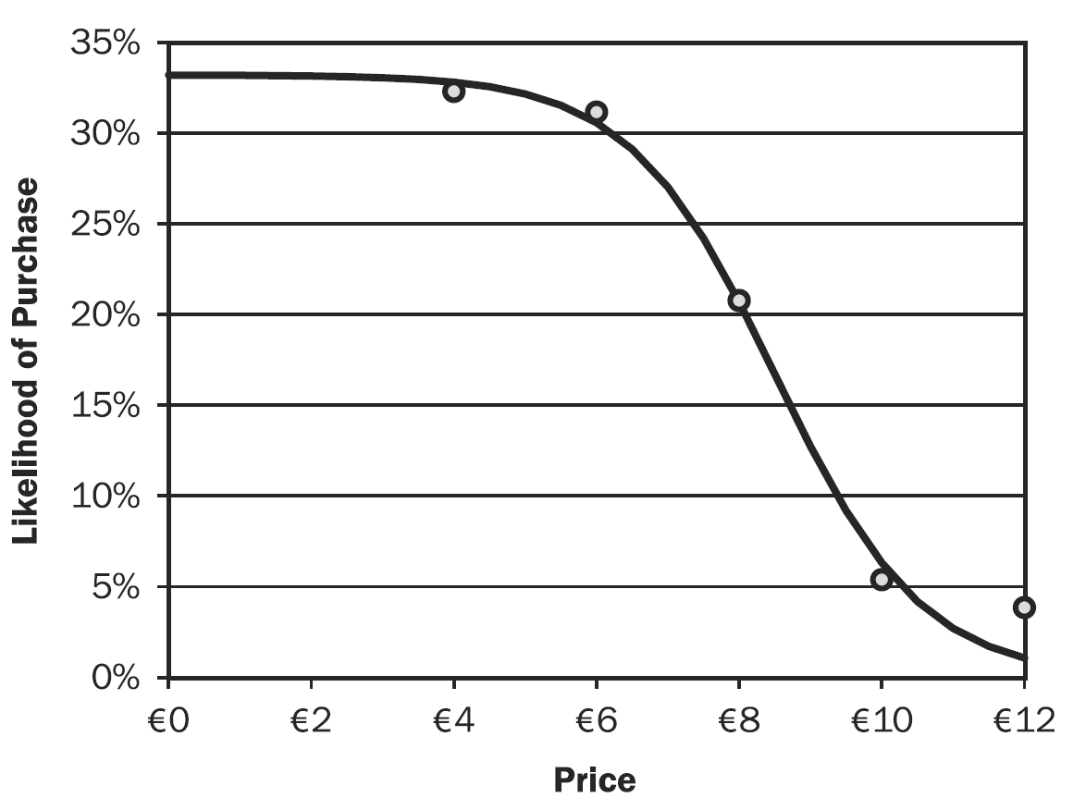
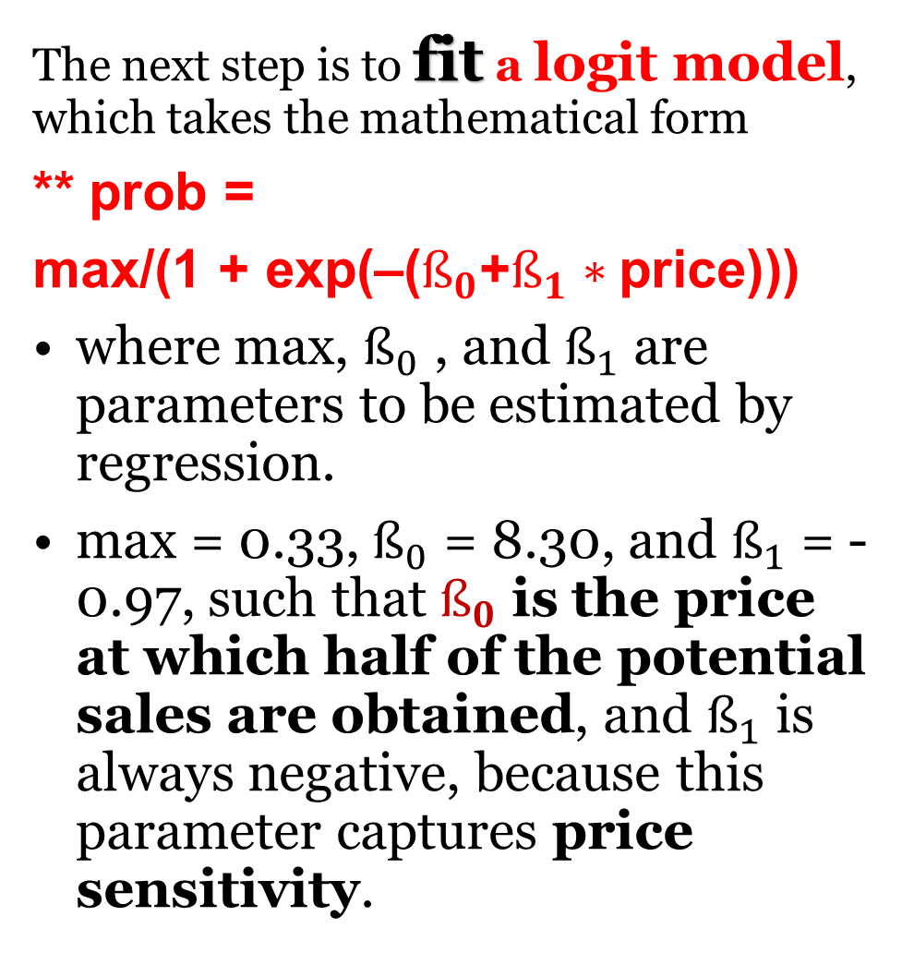
The Likelihood of Purchase Curve from Customer Data
The next step is to fit a logit model, which takes the mathematical form
** prob =
max/(1 + exp(–($ß_{0}$+$ß_{1}∗$price)))
where max, $ß_{0}$ , and $ß_{1}$ are parameters to be estimated by regression.
max = 0.33, $ß_{0}$ = 8.30, and $ß_{1}$ = -0.97, such that $ß_{0}$ is the price at which half of the potential sales are obtained, and $ß_{1}$ is always negative, because this parameter captures price sensitivity.

Slide 22
Introduction(...)
 | Ceiling | Intercept | Price | log(Price) | sqrt(Price) | BIC | Selected
Model 2 | 0.78 | -4.62 | -0.61 |  | 3.29 | 120.67 | YES
The estimated model has a ceiling parameter of 0.7769 . This means that the maximum attainable market share is 77.69 %
This logit model includes a ceiling, intercept and two slope parameters. Likelihood is a function of price and the square root of price.
The p-values of the parameters are highlighted in green if significant at 5% level.
In the majority of analyses, an alpha of 0.05 is used as the cutoff for significance. If the p-value is less than 0.05, we reject the null hypothesis that there's no difference between the means and conclude that a significant difference does exist. If the p-value is larger than 0.05, we cannot conclude that a significant difference exists.
That's pretty straightforward, right? Below 0.05, significant. Over 0.05, not significant.
The significance level is the probability of rejecting the null hypothesis when it is true. For example, a significance level of 0.05 indicates a 5% risk of concluding that a difference exists when there is no actual difference.

Slide 23
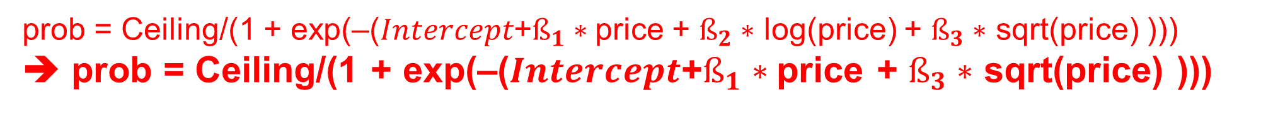
Introduction(...)
 | Ceiling | Intercept | Price | log(Price) | sqrt(Price) | BIC | Selected
Model 2 | 0.78 | -4.62 | -0.61 |  | 3.29 | 120.67 | YES
$Intercept$+$ß_{1}∗$price + $ß_{2}∗$ log(price) + $ß_{3}∗$ sqrt(price)
The estimated model has a ceiling parameter of 0.7769 . This means that the maximum attainable market share is 77.69 %
This logit model includes a ceiling, intercept and two slope parameters. Likelihood is a function of price and the square root of price.
The p-values of the parameters are highlighted in green if significant at 5% level.
** prob = max/(1 + exp(–($ß_{0}$+$ß_{1}∗$price)))
prob = Ceiling/(1 + exp(–($Intercept$+$ß_{1}∗$price + $ß_{2}∗$ log(price) + $ß_{3}∗$ sqrt(price) )))
➔ prob = Ceiling/(1 + exp(–($Intercept$+$ß_{1}∗$price + $ß_{3}∗$ sqrt(price) )))

Slide 24
Model fit

Slide 25
Model Parameters
 | Ceiling | Intercept | Price | sqrt(Price)
Values | 0.78 | -4.62 | -0.61 | 3.29
Standards errors | 2.56 | 6.45 | 0.43 | 2.54
P-value | 0.76 | 0.47 | 0.15 | 0.19
https://statisticsbyjim.com/regression/interpret-coefficients-p-values-regression/ ??
P-values seem to be too high (<0.05 is the default to accept a parameter, i.e., a DV)
The smaller the p-value, the stronger the evidence that you should reject the null hypothesis. A p-value less than 0.05 (typically ≤ 0.05) is statistically significant. It indicates strong evidence against (reject) the null hypothesis, as there is less than a 5% probability the null is correct (and the results are random).
Notes:
https://www.khanacademy.org/math/ap-statistics/xfb5d8e68:inference-categorical-proportions/idea-significance-tests/v/p-values-and-significance-tests

Slide 26
Model Fit
 | Measures of model fit
Root Mean Squared Error | 0.0134
R-squared | 0.9876
*McFadden R-squared | 0.1723
Bayesian Information Criterion | 120.6689
Best R-Squared for Logistic Regression
*Let L₀ be the value of the likelihood function for a model with no predictors, and let L_{M} be the likelihood for the model being estimated. McFadden’s R² is defined as
R²_{McF} = 1 – ln(L_{M)} / ln(L₀) -- “pseudo” R²
McFadden's pseudo R2 ranging from 0.2 to 0.4 indicates very good model fit
** The Bayesian Information Criterion (BIC) is an index used in Bayesian statistics to choose between two or more alternative models. BIC is a criterion for model selection among a finite set of models; models with lower BIC are generally preferred.

Slide 27
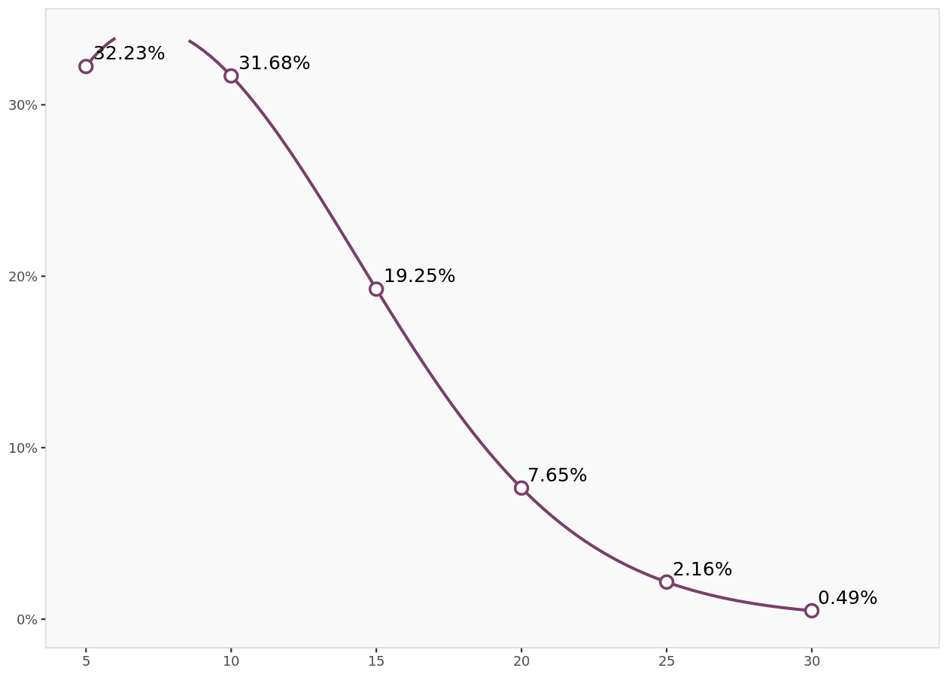
Predicted likelihood
These probabilities are aggregated and a response function is fit on the data, such that the aggregate demand level can be estimated at any price level.

Slide 28
Model predictions
 | Price level 1 | Price level 2 | Price level 3 | Price level 4 | Price level 5 | Price level 6
Price levels | 5.00 | 10.00 | 15.00 | 20.00 | 25.00 | 30.00
Purchase likelihood | 32.3% | 31.2% | 20.8% | 5.4% | 3.8% | 0.0%
Predicted likelihood | 32.2% | 31.7% | 19.2% | 7.6% | 2.2% | 0.5%
Predicted likelihood
=Ceiling/(1+EXP(-(Intercept+Parameter1*H23+Parameter3*SQRT(H23))))
Where H23 is the price such as 5 10, 15, etc.

Slide 29
Price optimization

Slide 30
Optimization results
Profit
Revenue
 | Prices | Predicted likelihood | Units sold | Gross profit | Cost | Net profit
Level 1 | 5.00 | 32.2% | 322 | 1 611.63 | 3 223.26 | -1 611.63
Level 2 | 10.00 | 31.7% | 317 | 3 168.40 | 3 168.40 | 0.00
Level 3 | 15.00 | 19.2% | 192 | 2 887.27 | 1 924.84 | 962.42
Level 4 | 20.00 | 7.6% | 76 | 1 529.18 | 764.59 | 764.59
Level 5 | 25.00 | 2.2% | 22 | 540.39 | 216.16 | 324.24
Level 6 | 30.00 | 0.5% | 5 | 147.13 | 49.04 | 98.09
Max Gross Margins | 11.69 | 28.1% | 281 | 3 285.32 | 2 810.56 | 474.76
Max Net Margins | 16.14 | 16.2% | 162 | 2 609.21 | 1 616.62 | 992.59
=Gross profit - Cost
=Price * Units Sold
=$10 * Units Sold
=Predicted likelihood *1000

Slide 31
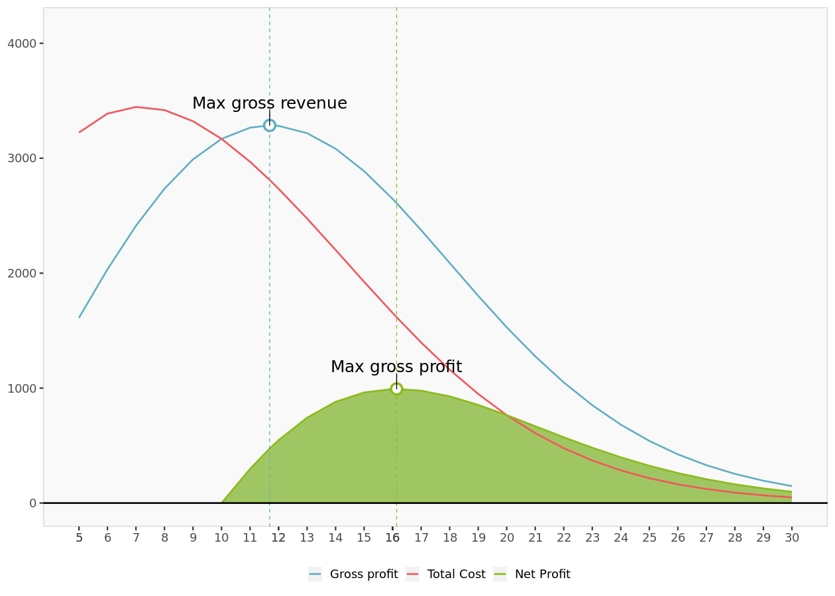
Price optimization
$ Profit
Total Cost
Gross Profit ➔ Revenue
Net Profit
Price

Slide 32
Price point examples
Example results
 | Prices | Predicted likelihood | Units sold | Gross profit | Cost | Net profit
Level 1 | 5.00 | 32.2% | 322 | 1 611.63 | 3 223.26 | -1 611.63
Level 2 | 6.00 | 33.9% | 339 | 2 032.86 | 3 388.09 | -1 355.24
Level 3 | 7.00 | 34.5% | 345 | 2 412.39 | 3 446.27 | -1 033.88
Level 4 | 8.00 | 34.2% | 342 | 2 735.15 | 3 418.93 | -683.79
Level 5 | 9.00 | 33.2% | 332 | 2 989.85 | 3 322.06 | -332.21
Level 6 | 10.00 | 31.7% | 317 | 3 168.40 | 3 168.40 | 0.00
Level 7 | 11.00 | 29.7% | 297 | 3 265.96 | 2 969.05 | 296.91
Level 8 | 12.00 | 27.3% | 273 | 3 281.44 | 2 734.53 | 546.91
Level 9 | 13.00 | 24.8% | 248 | 3 217.91 | 2 475.31 | 742.59
Level 10 | 14.00 | 22.0% | 220 | 3 082.74 | 2 201.96 | 880.78
Level 11 | 15.00 | 19.2% | 192 | 2 887.27 | 1 924.84 | 962.42
Level 12 | 16.00 | 16.5% | 165 | 2 645.78 | 1 653.61 | 992.17
Level 13 | 17.00 | 14.0% | 140 | 2 374.19 | 1 396.58 | 977.61
Level 14 | 18.00 | 11.6% | 116 | 2 088.39 | 1 160.21 | 928.17
Level 15 | 19.00 | 9.5% | 95 | 1 802.78 | 948.83 | 853.95
Level 16 | 20.00 | 7.6% | 76 | 1 529.18 | 764.59 | 764.59
Level 17 | 21.00 | 6.1% | 61 | 1 276.24 | 607.74 | 668.51
Level 18 | 22.00 | 4.8% | 48 | 1 049.42 | 477.01 | 572.41
Level 19 | 23.00 | 3.7% | 37 | 851.28 | 370.12 | 481.16
Level 20 | 24.00 | 2.8% | 28 | 682.07 | 284.20 | 397.87
Level 21 | 25.00 | 2.2% | 22 | 540.39 | 216.16 | 324.24
Level 22 | 26.00 | 1.6% | 16 | 423.79 | 163.00 | 260.79
Level 23 | 27.00 | 1.2% | 12 | 329.27 | 121.95 | 207.32
Level 24 | 28.00 | 0.9% | 9 | 253.66 | 90.59 | 163.07
Level 25 | 29.00 | 0.7% | 7 | 193.88 | 66.86 | 127.03
Level 26 | 30.00 | 0.5% | 5 | 147.13 | 49.04 | 98.09

